Slide 1


Slide 2


Slide 3


Slide 4
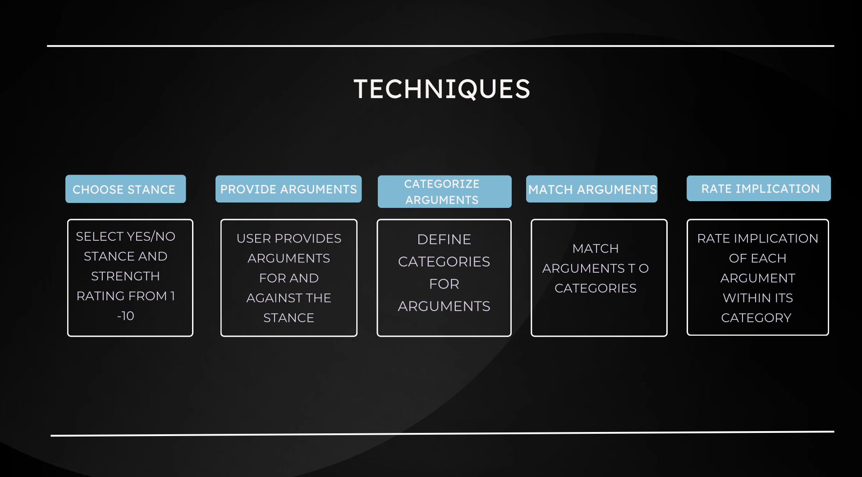

Slide 5


Slide 6
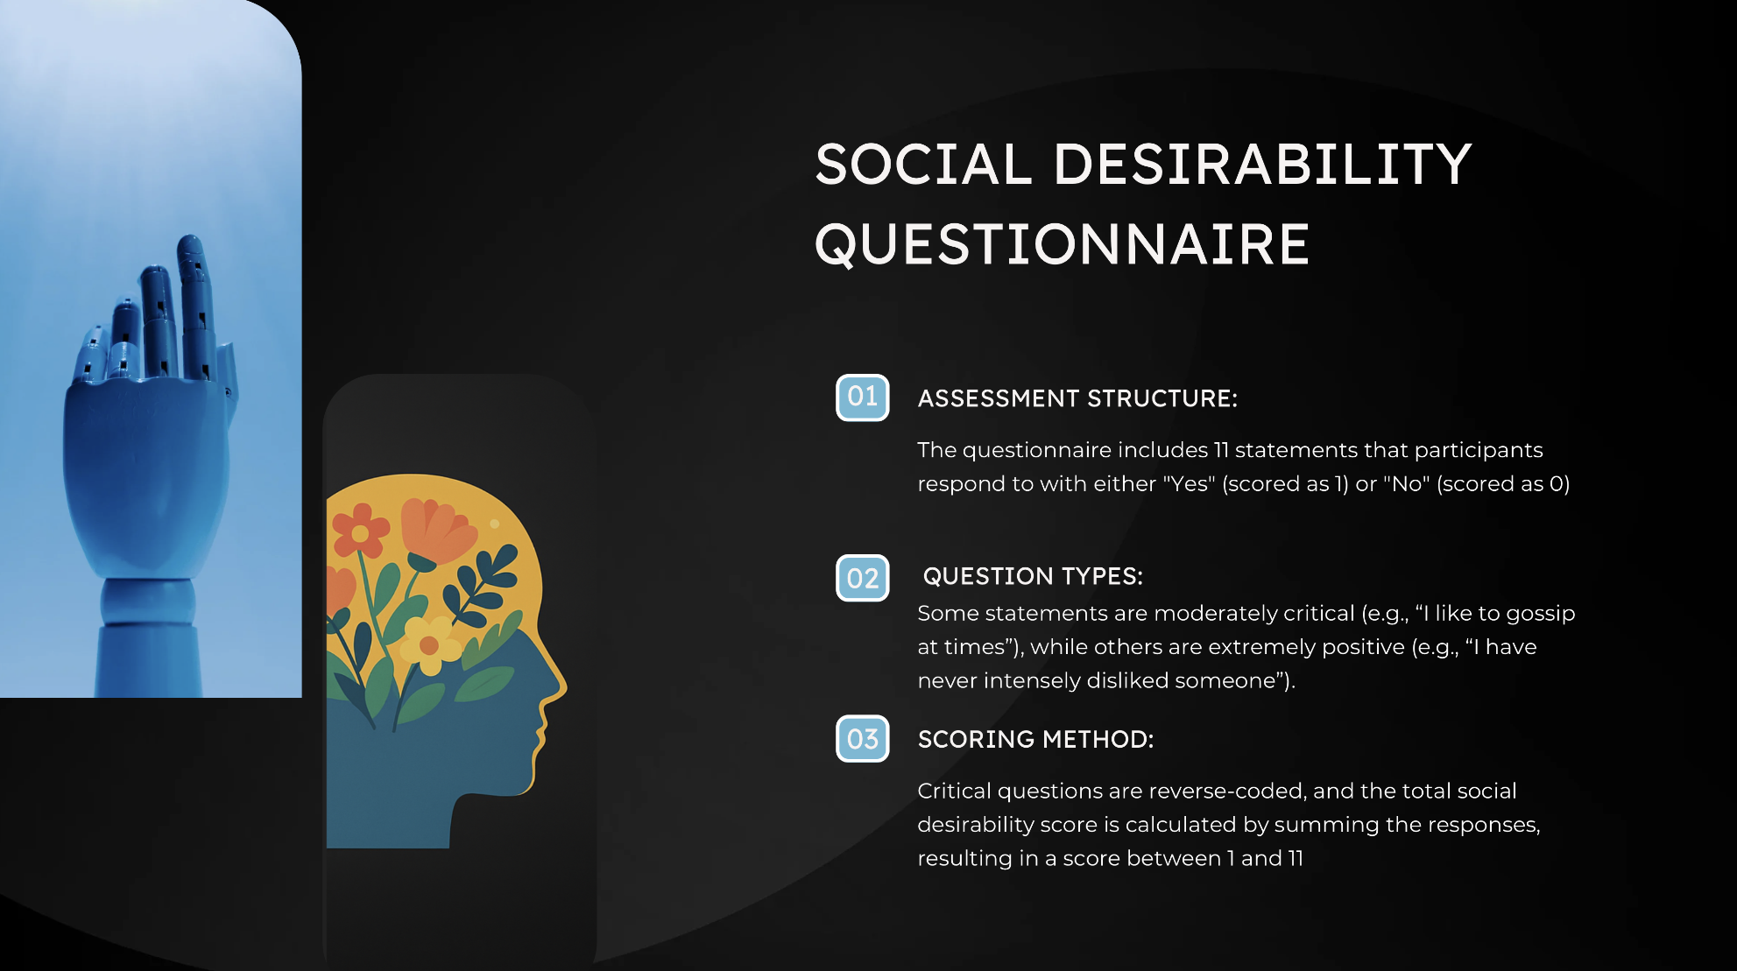

Slide 7
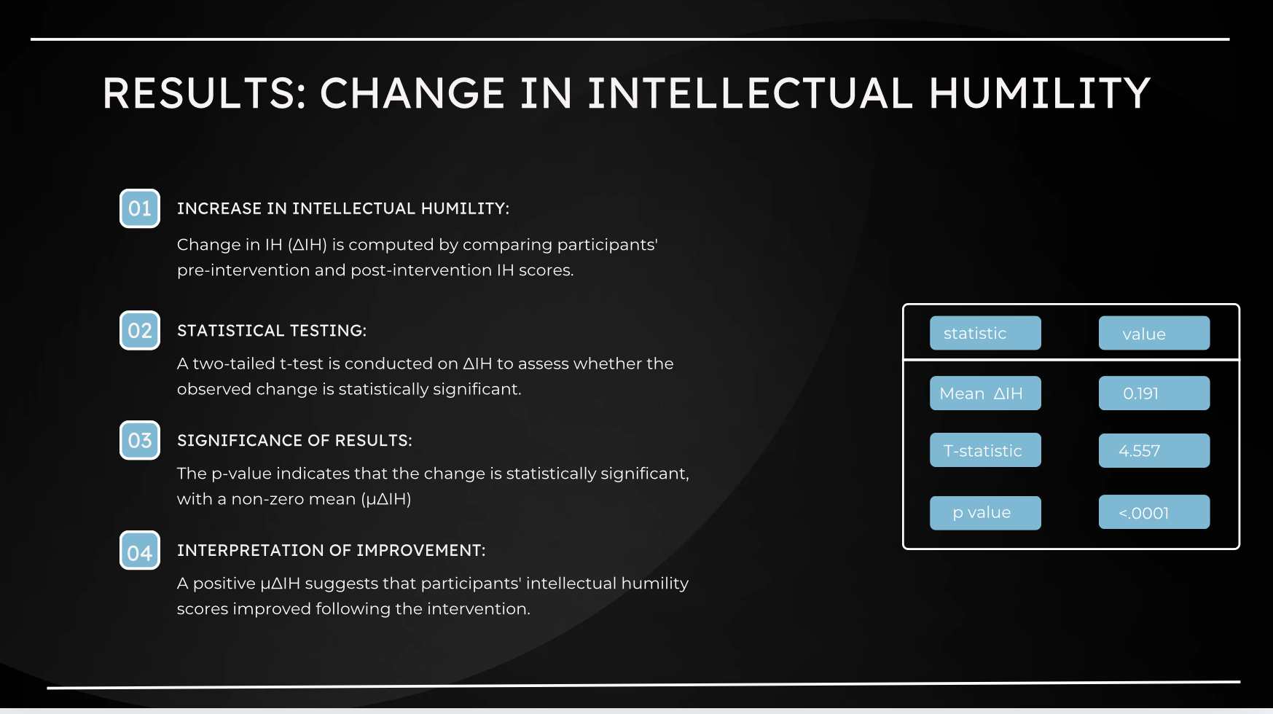

Slide 8
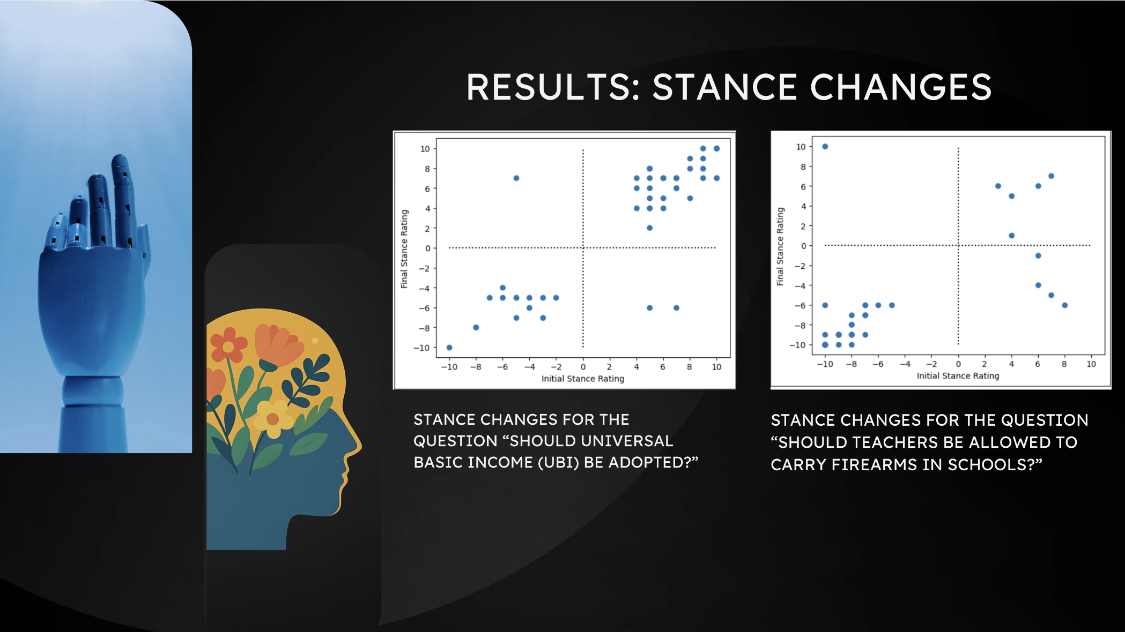

Slide 9
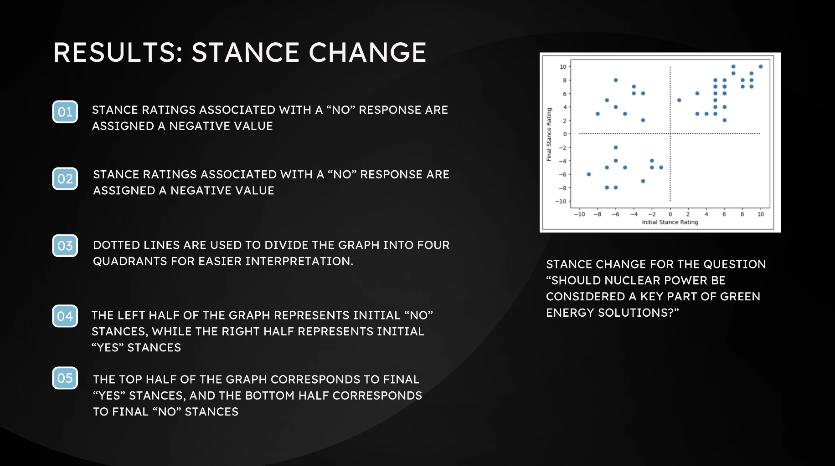

Slide 10
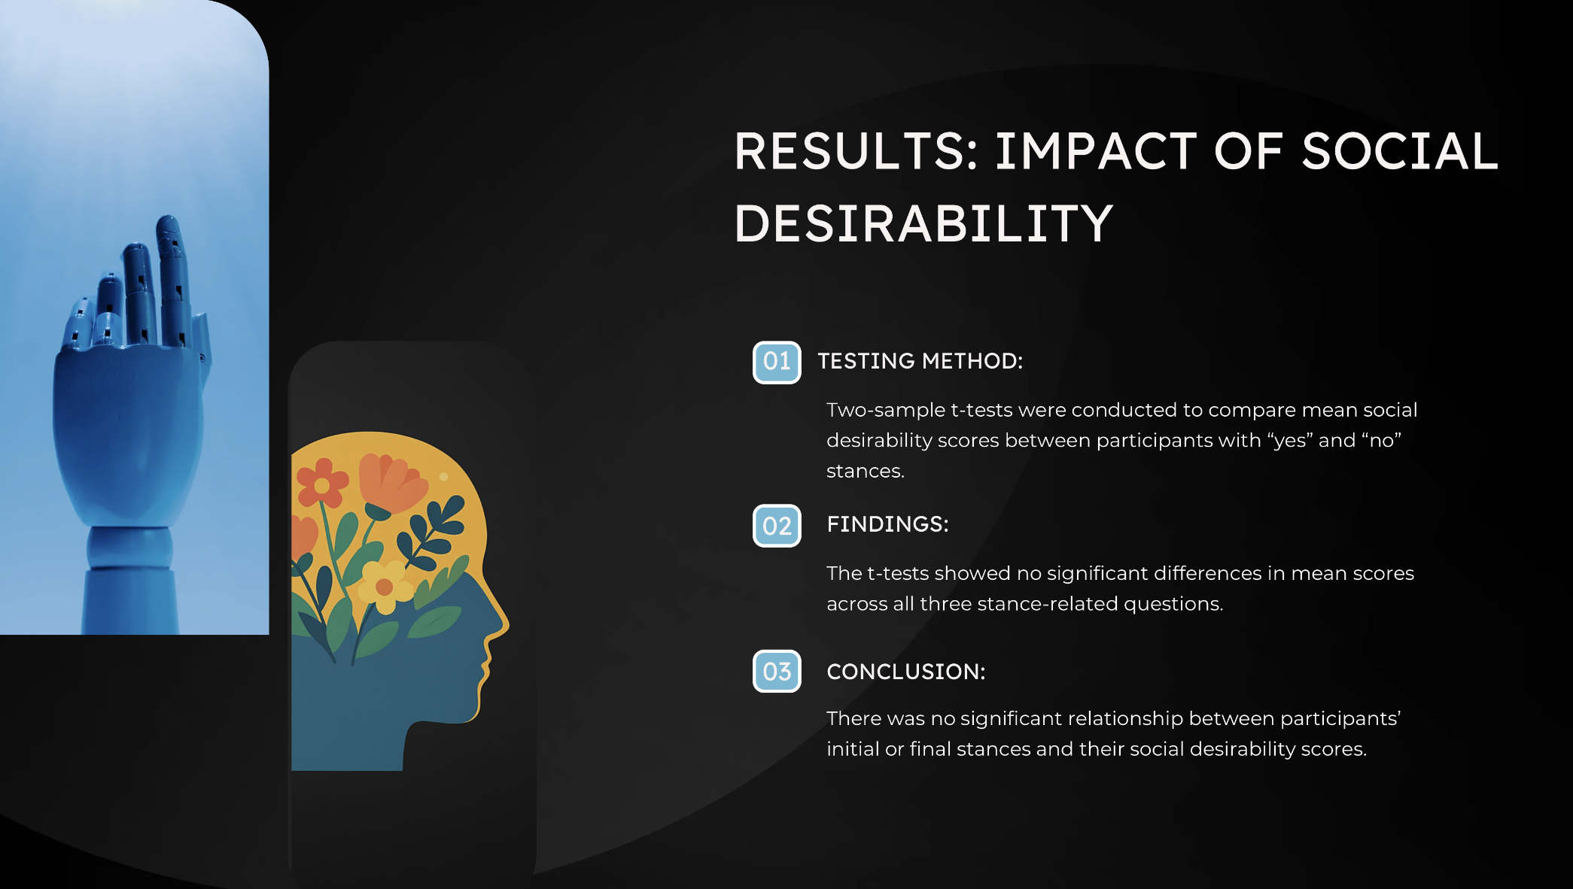

Slide 11
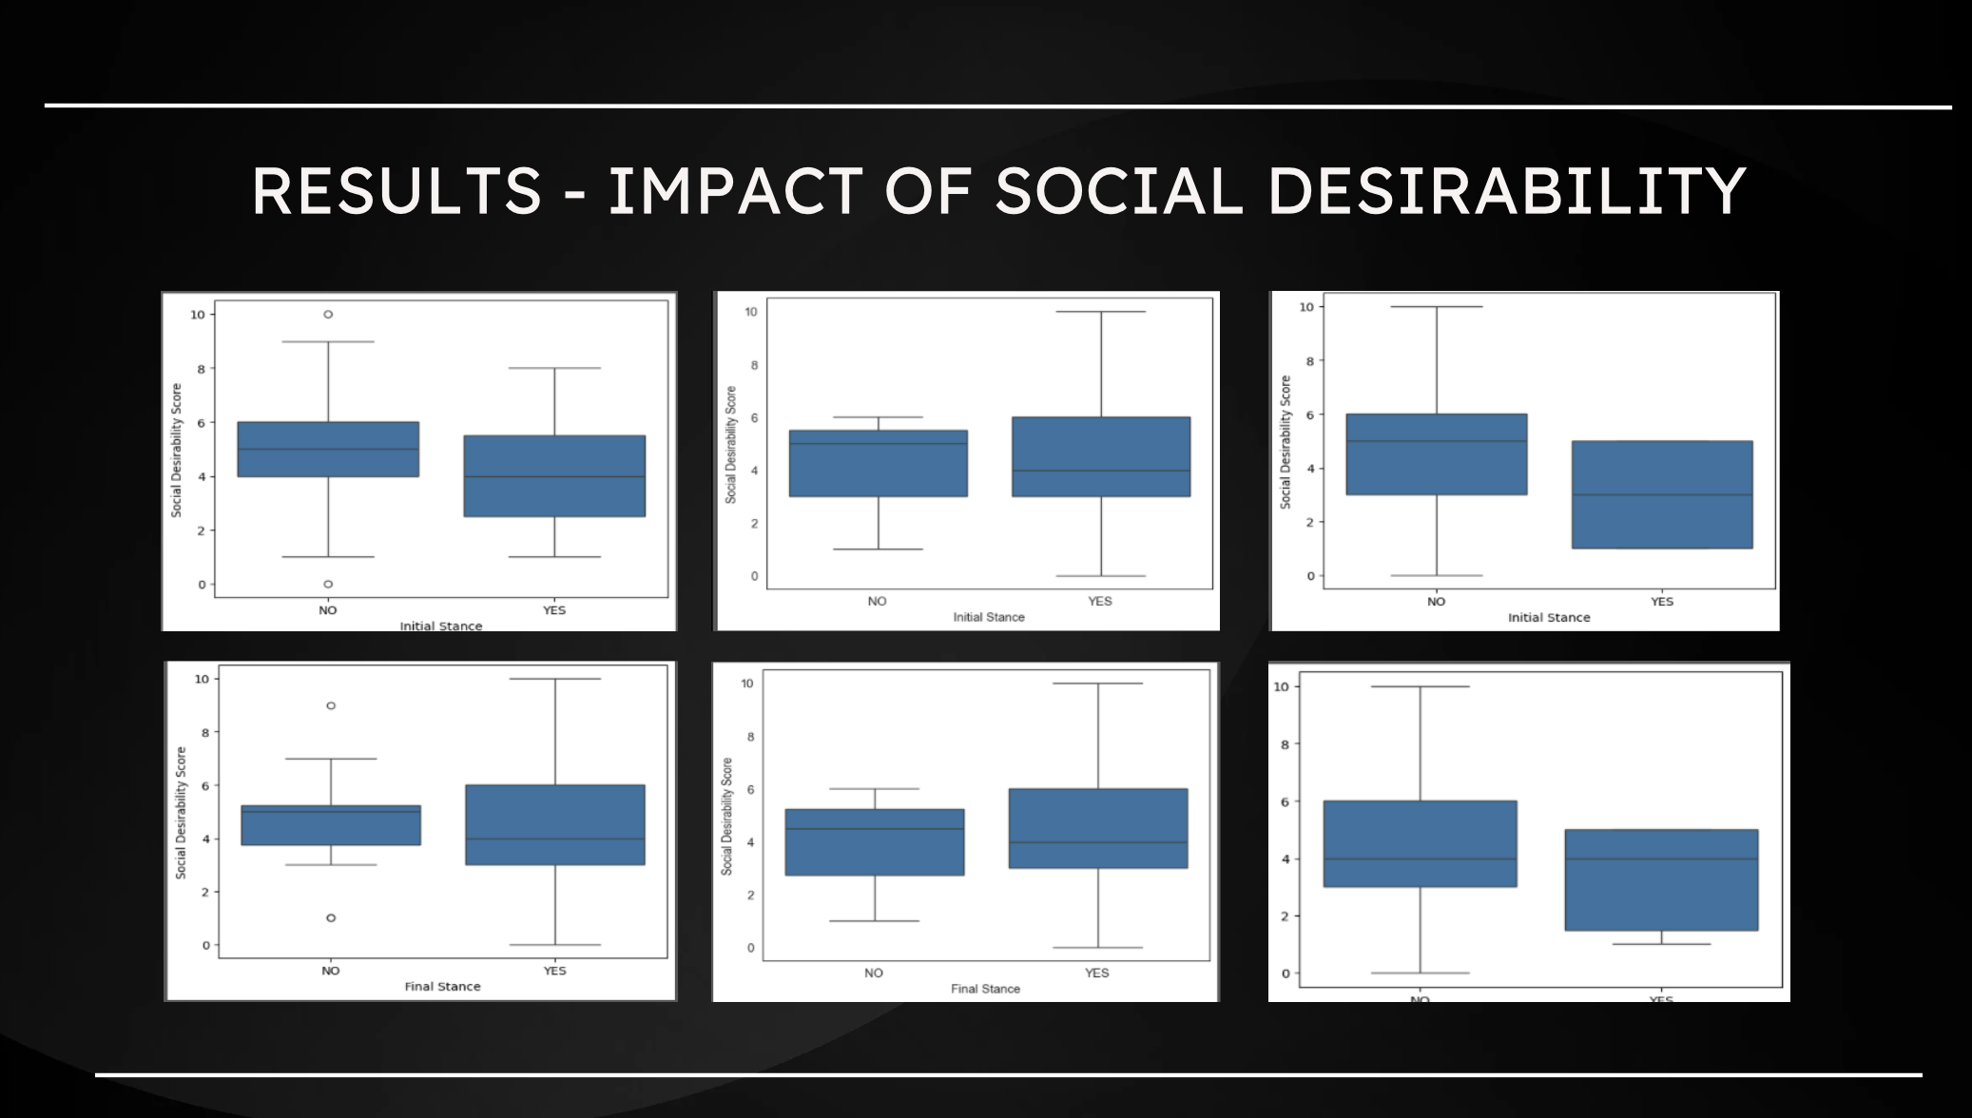

Slide 12
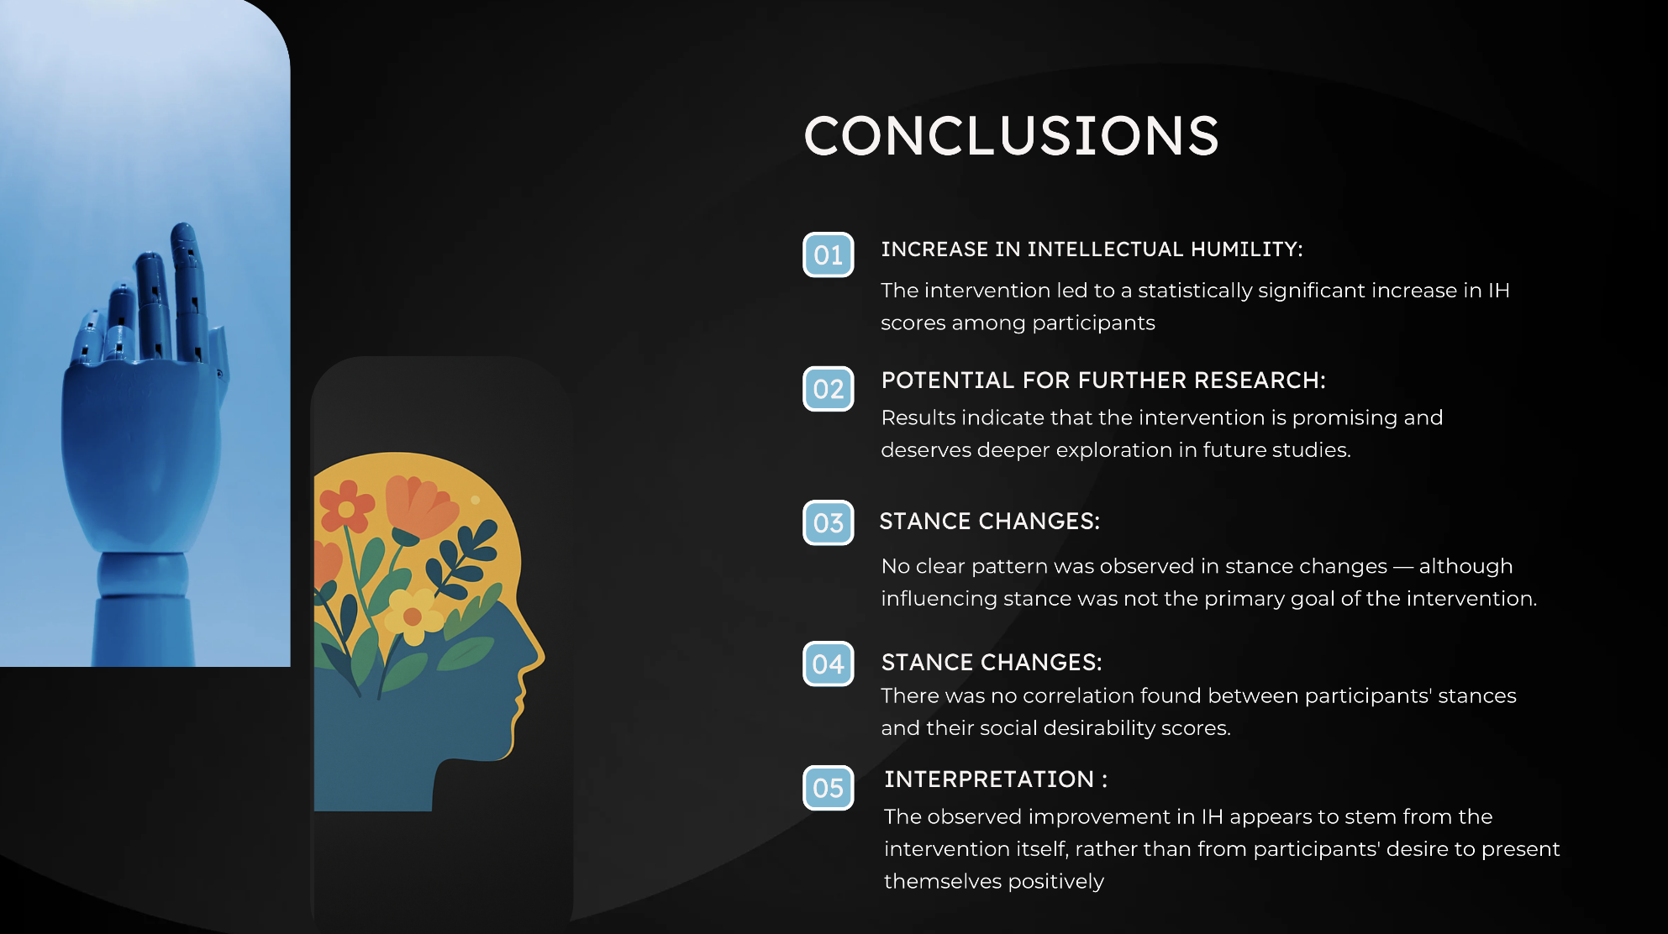

Slide 13


Slide 14
Results - change in IH
Change in IH (Δ_{IH}) is calculated from pre and post intervention IH scores.
Two tailed t-test is performed on the Δ_{IH} to check for significance.
P-value suggests significance and μ_{ΔIH} is non-zero.
Positive μ_{ΔIH} suggests improvement in IH scores after intervention.
Statistic | Value
Mean Δ_{IH} | 0.191
T-statistic | 4.557
p-value | < .0001

Slide 15
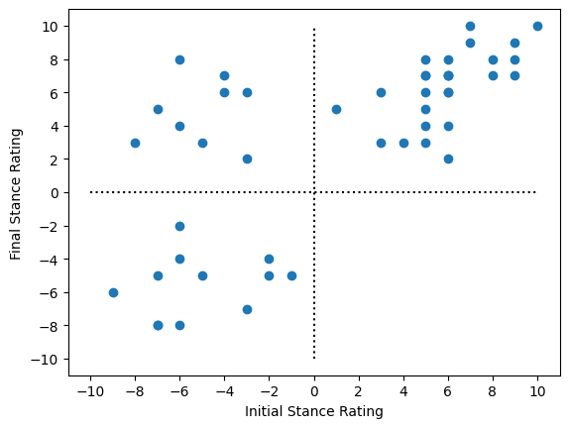
Results - Stance Change
Stance ratings for “no” stance are given negative valence.
Position scale becomes -10 to 10.
Dotted lines divide graph into 4 quadrants.
Left and right halves represent initial “no” and “yes” stances respectively.
Top and bottom halves represent final “yes” and “no” stances respectively.
Stance change for the question “Should nuclear power be considered a key part of green energy solutions?”

Slide 16
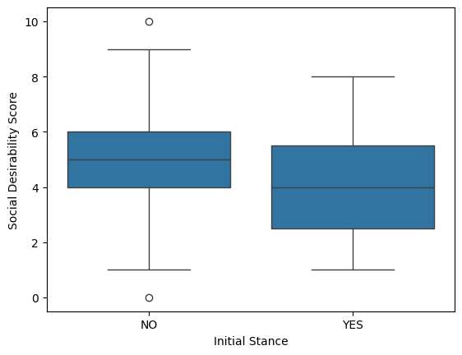
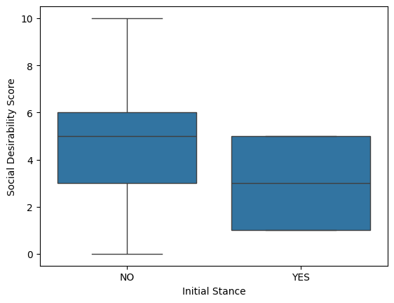
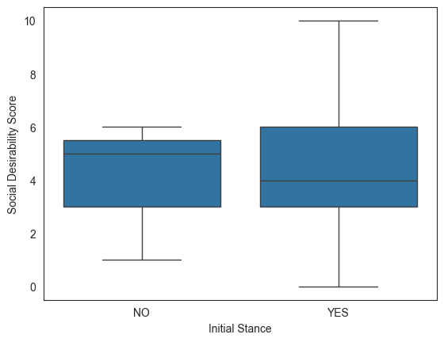
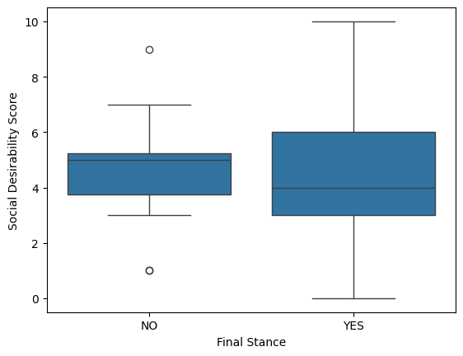
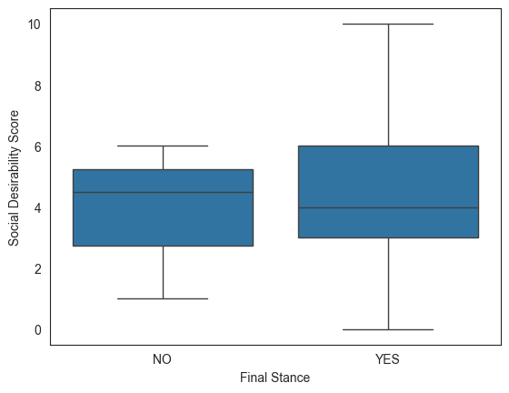
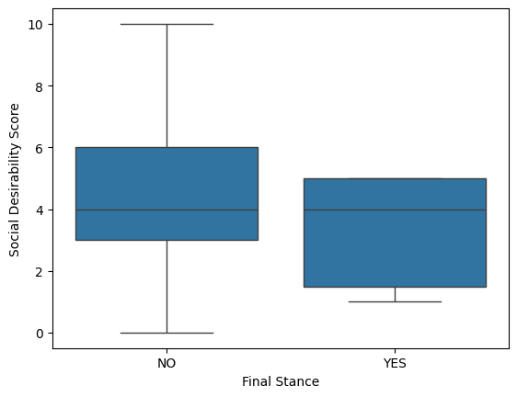
Results - impact of social desirability

Slide 17
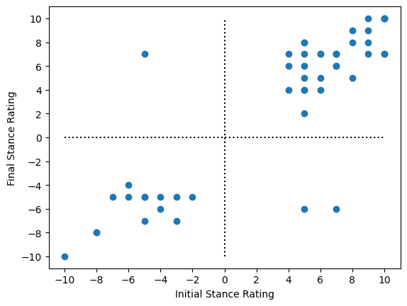
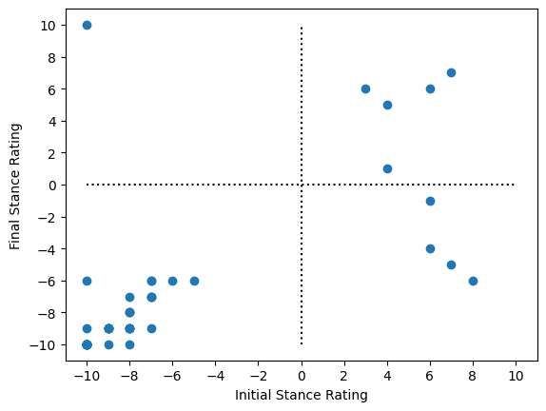
Results - Stance Changes
Stance changes for the question “Should universal basic income (UBI) be adopted?”
Stance changes for the question “Should teachers be allowed to carry firearms in schools?”

